Slide 1
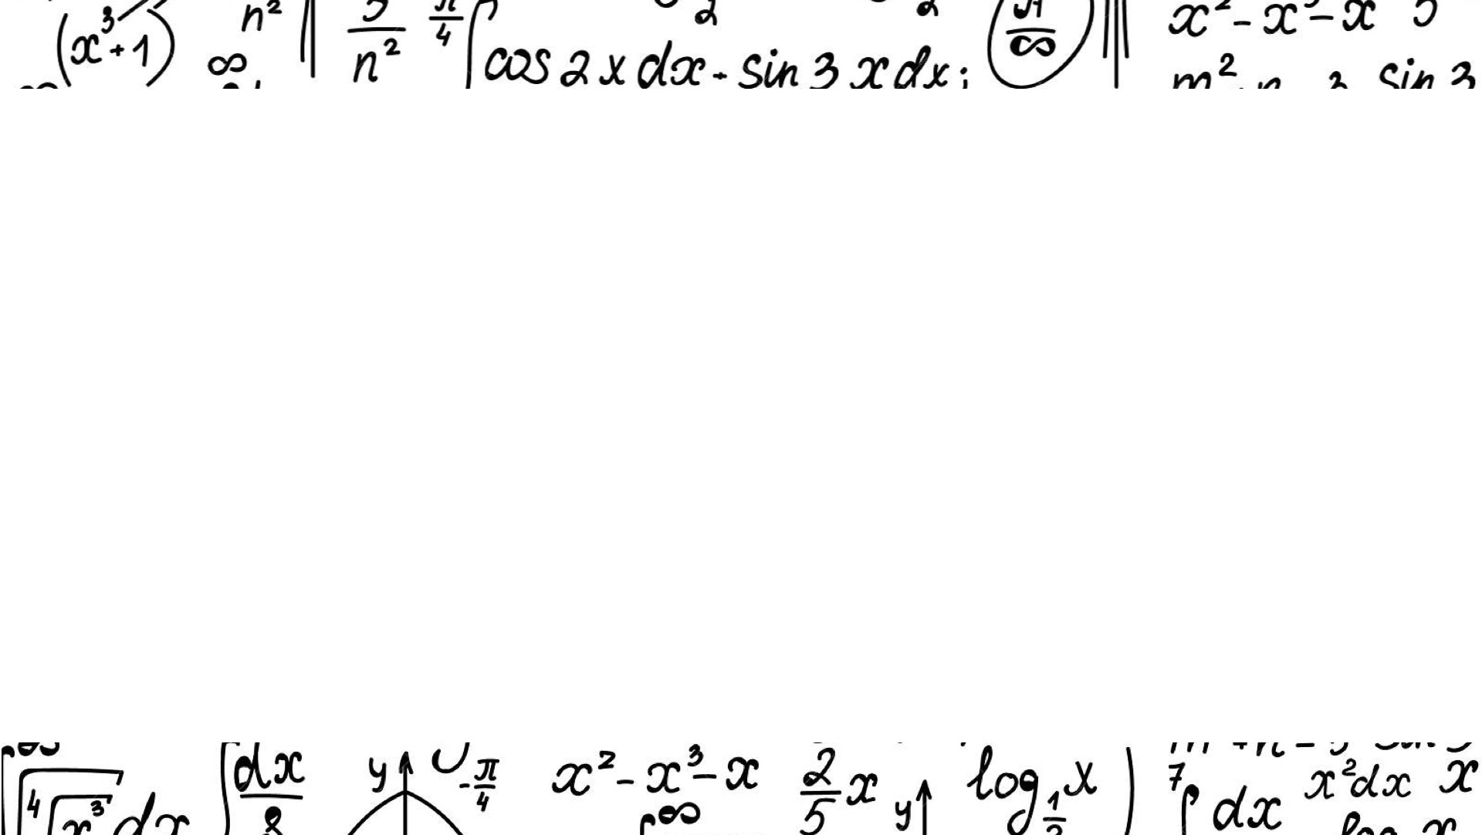
Classifying Handwritten Math Symbols
By Bianca Orozco
Notes:
Good morning
my name
thank you for being here
As a mathematician I know how tedious to type equations
Many would say mathematicians are averse to tech
I would argue
For this reason, I decided to focus my final project

Slide 2
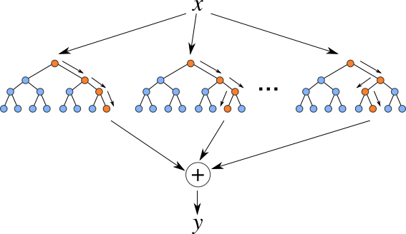




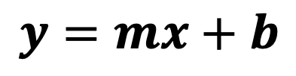
Methodology
$$y=mx+b$$
Kaggle Dataset
Handwritten to text
Random Forest Model
Accuracy: 0.75
Notes:
In order to do this, I received my dataset from Kaggle
which consisted of thousands of handwritten math symbol images
After much data cleaning, balancing, and restructuring
I was able to use this data to train my Random Forest Model
I then tested this model by using the Notes app in my phone
Now I'd like to show you a demonstration of this
random forest diagram

Slide 3
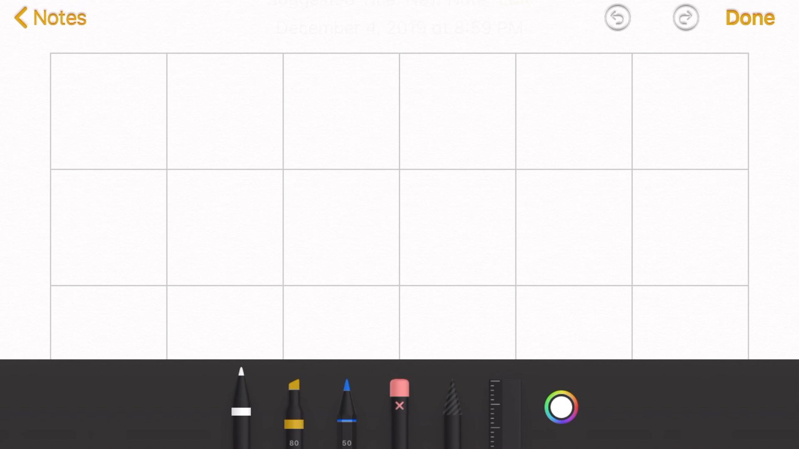
Demonstration

Slide 4
Uses and Next Steps
Math writing app
Variety of writing styles and math symbols
Notes:
This model could serve as the basis for a math writing application
with the tablet and smart pen functionality we h

Slide 5
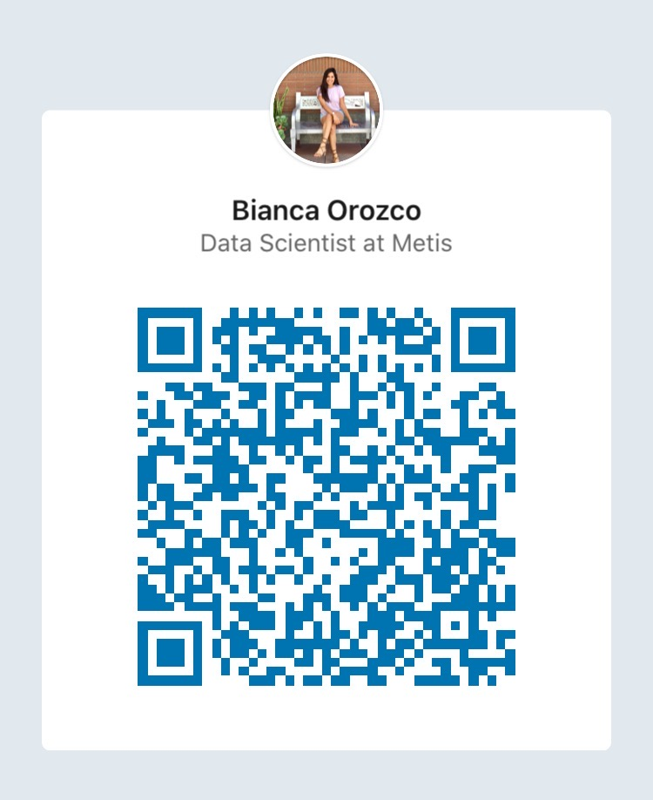




Thank You
biancaorozco
biorozco3
biorozco3
biorozco3@gmail.com
Notes:
I’d love to connect with you to talk about Call to action!

Slide 6
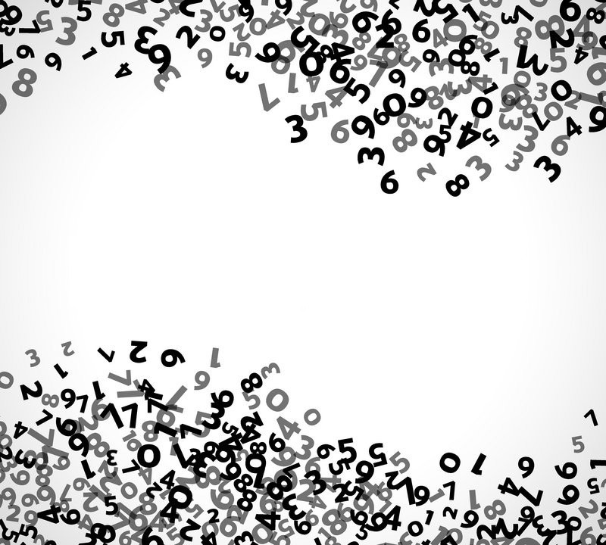
LaTeX
mean equation
by hand with latex type

Slide 7
Classifying Handwritten Math Symbols
By Bianca Orozco
Notes:
Good morning
my name
thank you for being here
As a mathematician I know how tedious to type equations
Many would say mathematicians are averse to tech
I would argue
For this reason, I decided to focus my final project

